Slide 1
What is a Time Line?
By Mrs. Jo and Mr. G

Slide 2
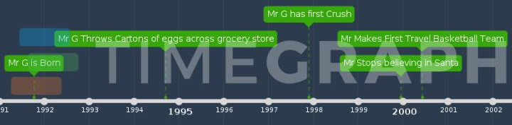
Is it this?

Slide 3
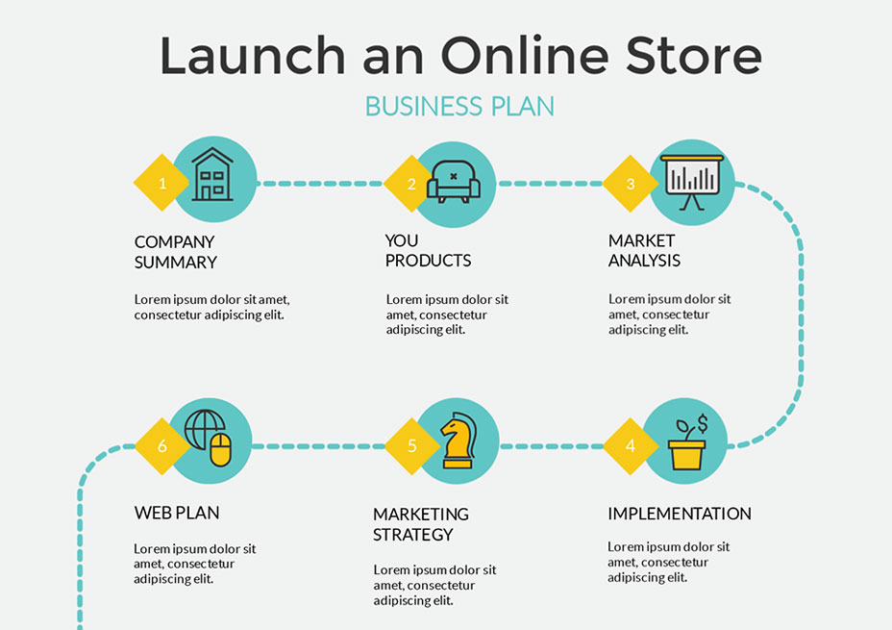
Or Maybe this?
(Online Store)

Slide 4
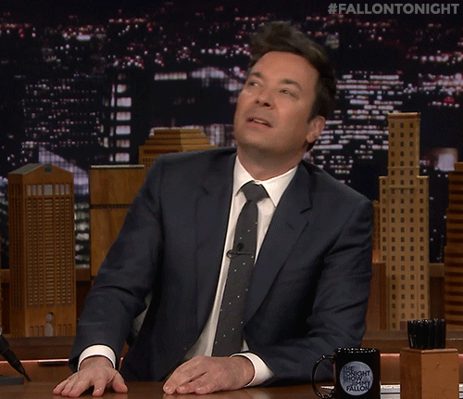
(Jimmy)

Slide 5
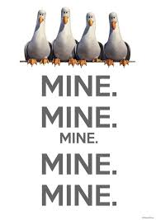
Well, What is It?
It’s in YOUR planner!
My Friend’s Planner?
  NO
My Group’s Planner?
  No
My Notebook?
  No
Rando Piece of paper?
  No
(Mine)

Slide 6
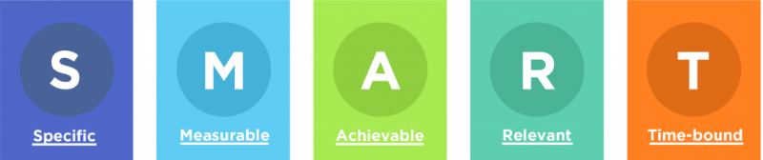
Smart Goals
S- Is it super detailed or vague?
M- Is it weighted? Valued? Numbered? Quantitive? Clearly done?
A- Could I reasonably accomplish this task?
R- Is it working towards my bigger goal?
T- is there a daily check point or due dates?
(Smart)

Slide 7
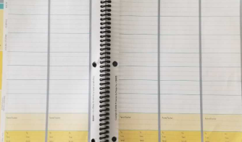
Is this SMART?
Steam-
Finish Design in SketchUp
Start Working on Physical 3D Model
Steam-
Finish Working on Physical 3D Model
Take Pictures of 3D Model
Steam-
Complete:
Intro Slide
Engage Slide
Explore Slide
Get 3 pictures for PowerPoint
Steam-
Complete:
70% of Research
3 of the 4 C’s
Steam-
Finish Research
4 C’s
Works Cited
Conclusion
Present Monday

Slide 8
Work Cited
Online Store https://www.visme.co/timeline-maker/
Jimmy https://giphy.com/gifs/fallontonight-jimmy-fallon-mood-tonight-show-BMtGb8JSk2Ln1cnPMA
Mine https://www.pinterest.com/pin/447967494159020487/
Smart https://fitsmallbusiness.com/smart-goals-examples/

